Slide 1
DecepTIV: A Large-Scale Benchmark for Robust Detection of T2V and I2V Synthetic Videos
Sotiris Stamnas
Supervised by Victor Sanchez and Vitomir Struc
JAMS , 3rd June 2025

Slide 2
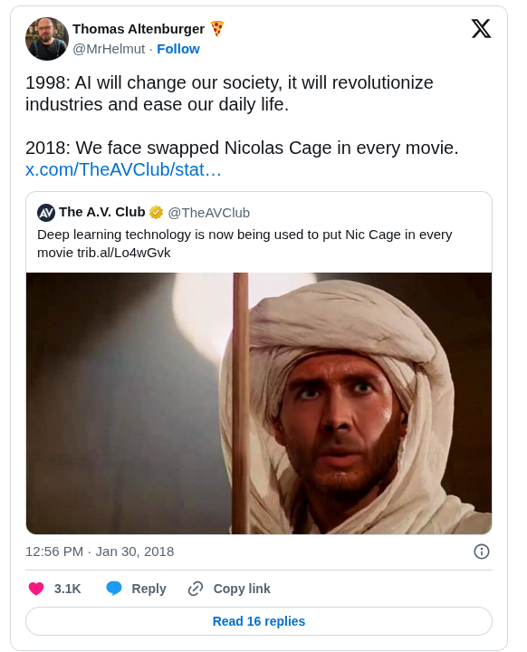
Deepfakes – What does it mean?
1
Term used to describe synthetic media created with malicious intent, typically featuring human faces
Deep learning + fake visual data = Deepfake
The term first apperared in 2017
User named "Deepfake" on Reddit
Generates multiple pornographic videos with face-swapped celebrities
And a lot of videos with Nicholas Cage

Slide 3
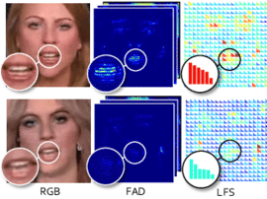
Deepfake Detection
2
The development of robust deepfake detectors is an active area of research
Existing deepfake detectors utilize deep CNNs and machine learning
Extract forensic traces from:
Spatial domain
Frequency domain
Temporal incosistencies
Anomaly detection-based techniques
Real
Fake

Slide 4
A Novel Type of Synthetic Videos: T2V and I2V
3
Most recently, two novel synthetic video generation paradigms, Text-To-Video (T2V) and Image-To- Video (I2V) have revolutionized generative AI
T2V generates a fully synthetic video based on a input text-prompt
I2V generates temporally consistent videos based on an input starting frame + a prompt describing the scene dynamics

Slide 5
Experiment: Find the Real News Reporter
4
Fake: Veo 3
Real: ABC World News

Slide 6
Detection of T2V and I2V Media -- DecepTIV
5
There has been little to no research in detecting T2V and I2V media
Main reason is the lack of reliable open-source detection dataset
We introduce DecepTIV a large scale fake video detection dataset containing thousands of videos from the latest T2V and I2V models
We address major disadvantages of existing detection datasets
Unclear generation pipeline
Lack of good practises such as prompt enhancement
Existing datasets contain cartoon-like characters and unrealistic scenes
There is no content correlation between real and fake videos

Slide 7
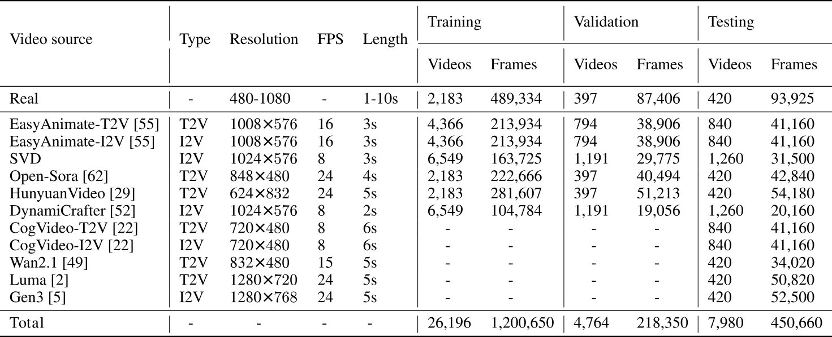
DecepTIV – Overview
6
Our goal is to create fake videos whose content is dependent on real reference videos and include scenes where misinformation could pose a threat
We utilize the YouTube-8M benchmark to extract videos categorized under firefighter, soldier and weather

Slide 8
DecepTIV – Generation Pipeline for Fake Videos
7

Slide 9
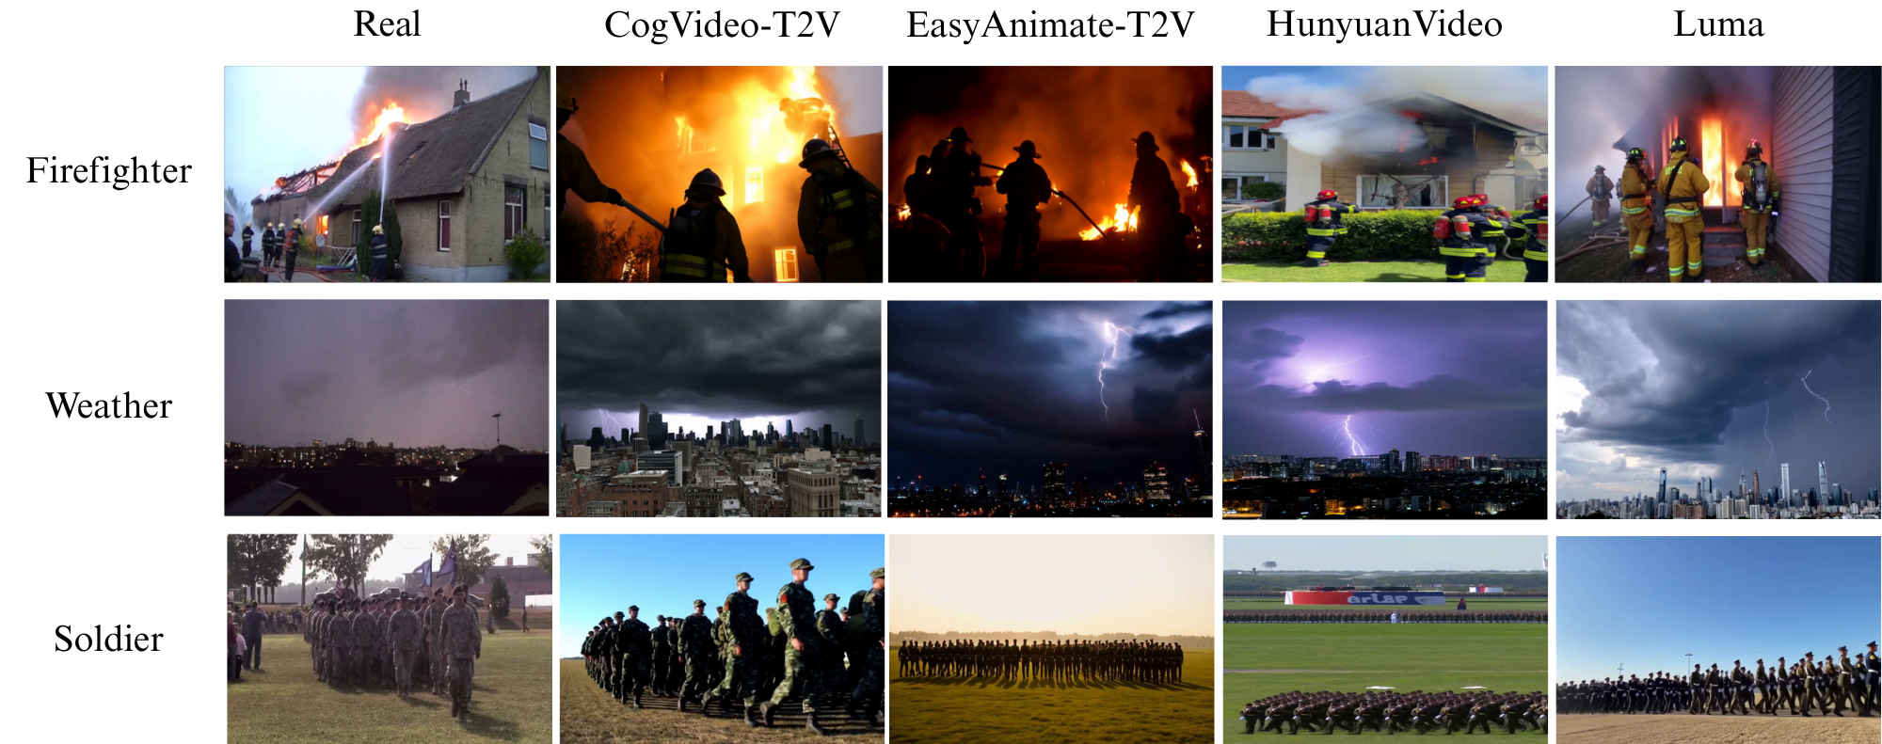
DecepTIV: Video Samples
8
Caption 1: A group of firefighters is actively fighting a fire in a house
Caption 2: A cloudy sky over a city with buildings, with lightning in the sky
Caption 3: A group of military men standing in a field, marching in formation

Slide 10
DecepTIV – Evaluation protocol
9
In addition to the dataset, we propose an evaluation protocol for detectors trained on DecepTIV that replicates three common real-world detection scenarios
In-generator evaluation
Cross-generator evaluation
Perturbed video evaluation

Slide 11
DecepTIV – Experimental Setup
10
We Leverage eight existing general-purpose fake image/video detectors
4 Backbone-based detectors
2 Frequency-based detectors
2 Temporal-based detectors
Evaluation metrics:
Class-wise accuracies (ACC)
Area under the Receiver Operating Characteristic curve (AUC)
F1 score

Slide 12
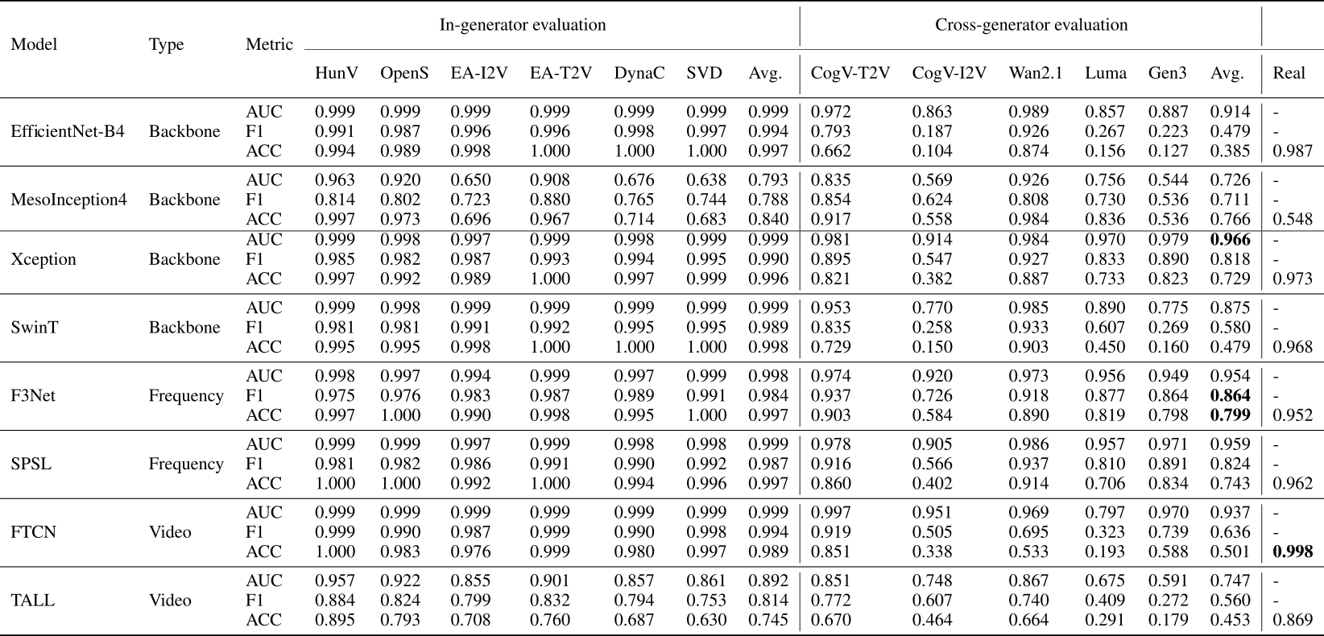
DecepTIV – In and Cross Generator Evaluation
11

Slide 13
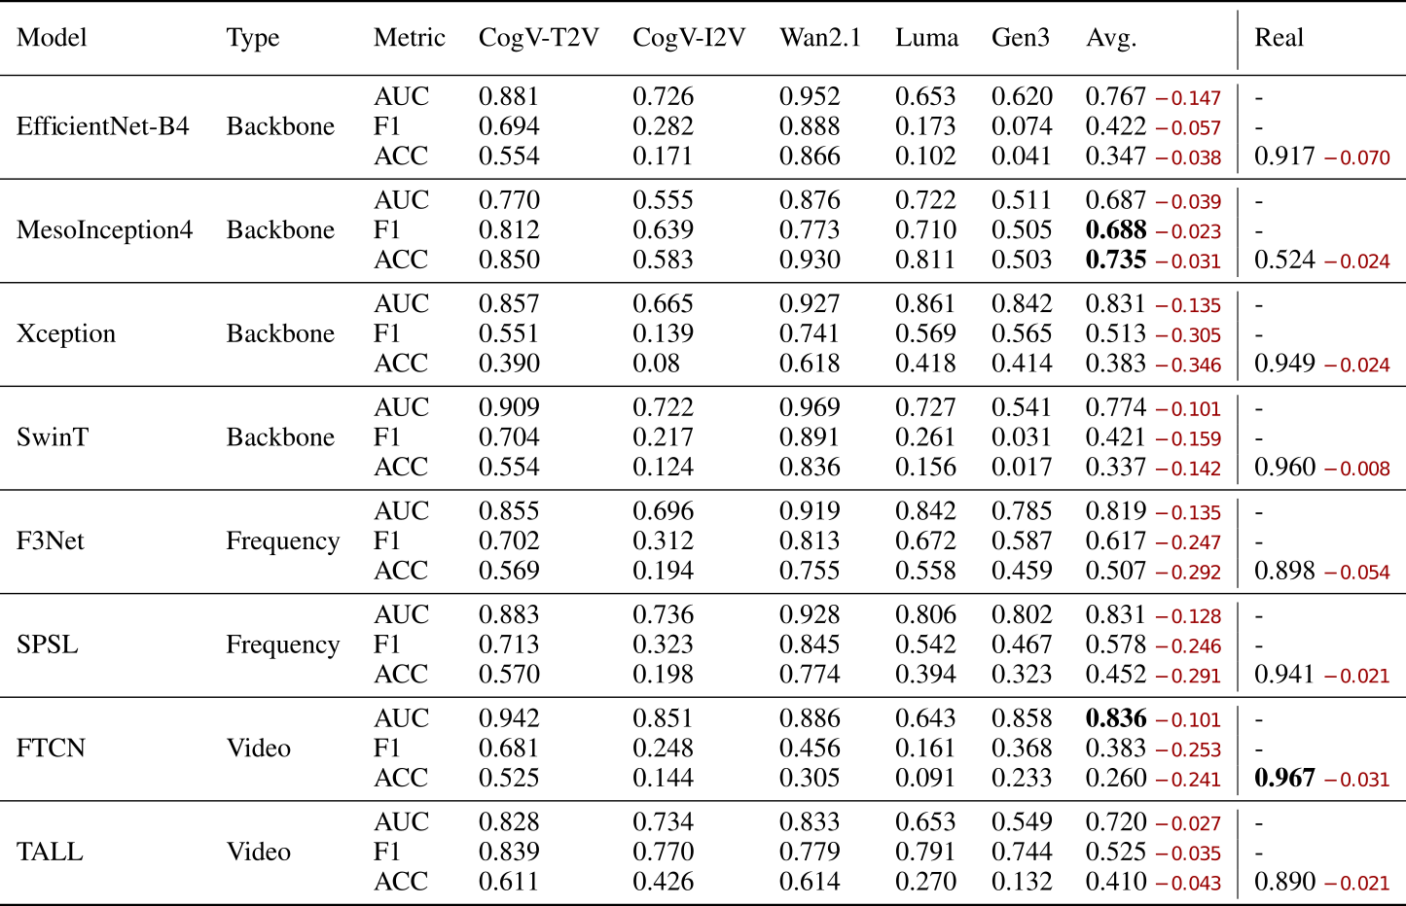
DecepTIV – Perturbed Video Evaluation
12

Slide 14
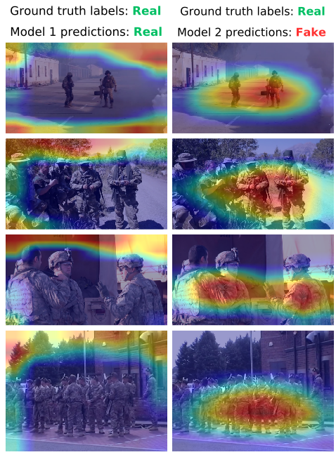
DecepTIV – Effect of Content Correlation
13
To highlight the importance of content-correlated real and fake videos, we investigate an extreme case where their content is entirely uncorrelated
Model 1: Trained on real and fake videos of class soldier
Model 2: Trained on real videos of class firefighter and fake videos of class soldier

Slide 15
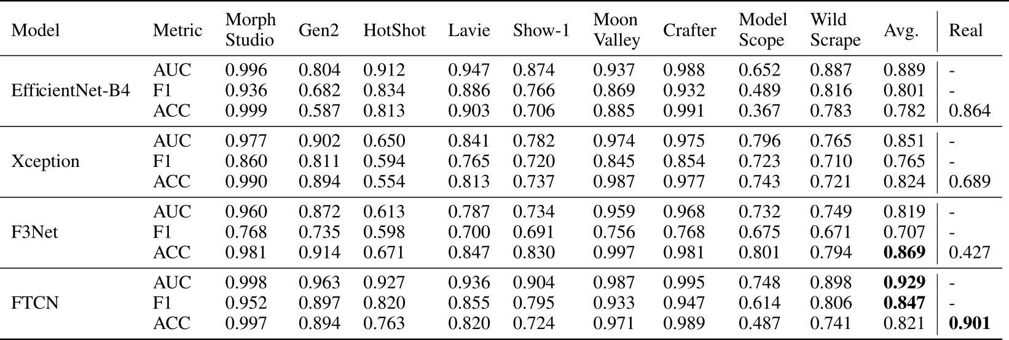
DecepTIV – Cross-Dataset Experiment
14
A main limitation of DecepTIV is the narrow semantic scope of its video set
Are detectors trained on DecepTIV able to generalize to synthetic videos from external sources?
Yes :)
Performance on GenVideo dataset of Chen et al.

Slide 16
DecepTIV – Conclusions and Future Work
15
We introduced DecepTIV a large-scale fake video detection dataset containing videos from the latest T2V and I2V models
Our fake video generation pipeline is modular and facilites future dataset expansion as new generative methods emerge
We proposed a thorough evaluation protocol that simulates three real-world settings
Include videos from additional semantic categories to adress narrow semantic scope
Generate videos from latest models like Sora, Veo3 etc
Propose a new detector specifically tailored towards T2V and I2V media

Slide 17
16
Code
Dataset
Email

Slide 18
17

